Slide 1

“ c JARVIS”
Sakthiraj Kandasamy
Sundaram Duraisamy
Praveen Suresh
a project by

Slide 2


Slide 3
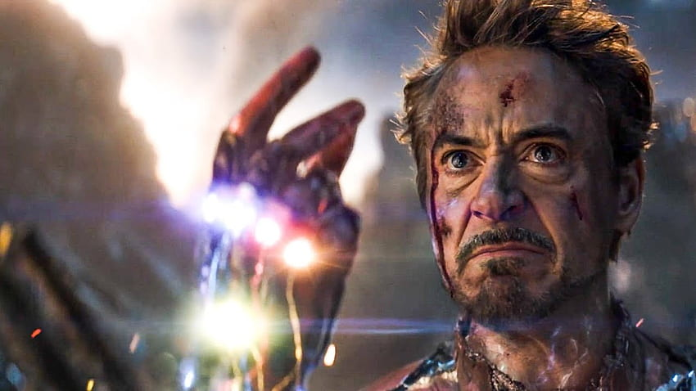
We are NOT Iron Man…
to solve universe problems in
a snap of the finger…

Slide 4
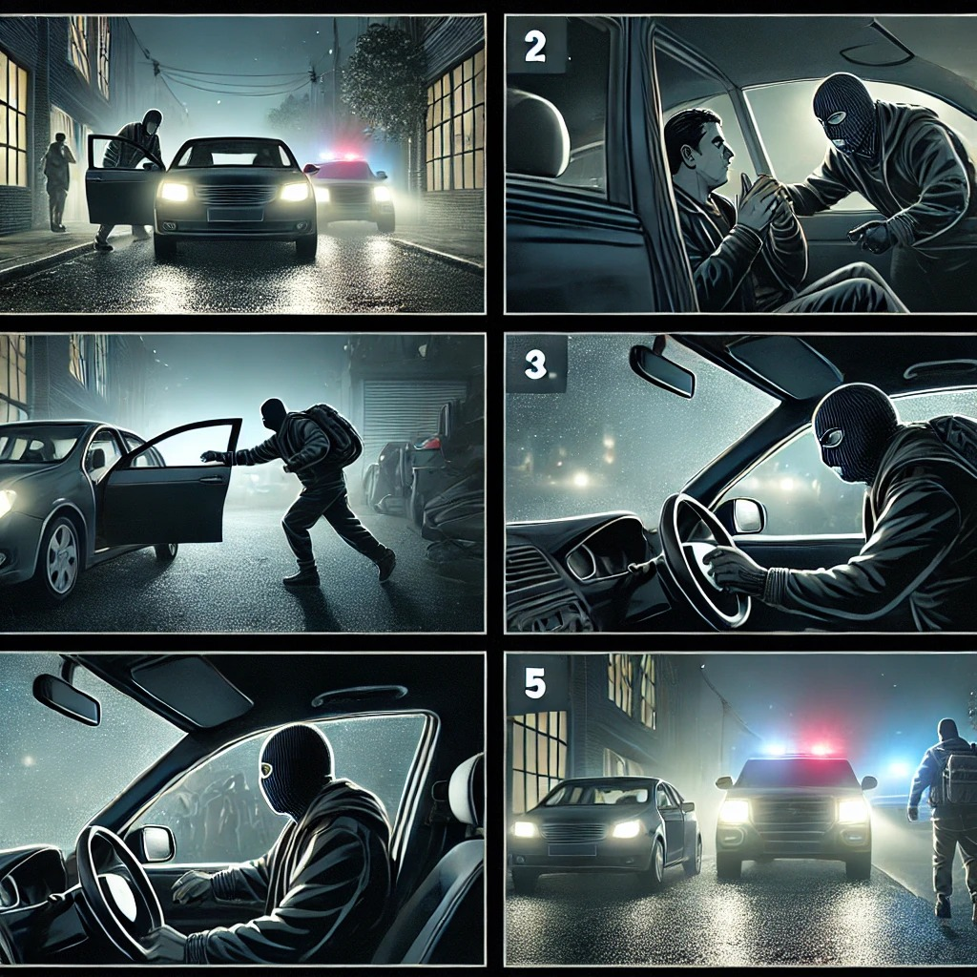
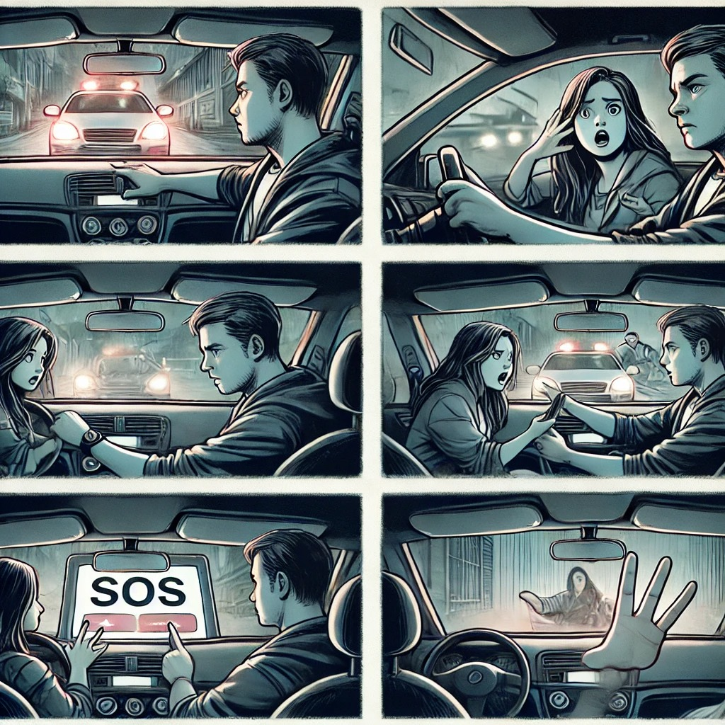
Car Jacking & Road Violence

Slide 5
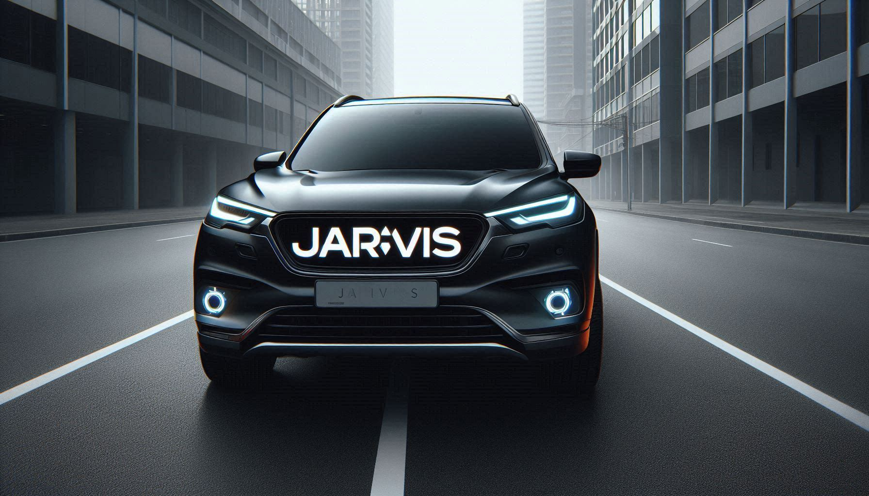
So, we built… “ car Jacking And Road Violence Information System ” version 0.001

Slide 6


Slide 7
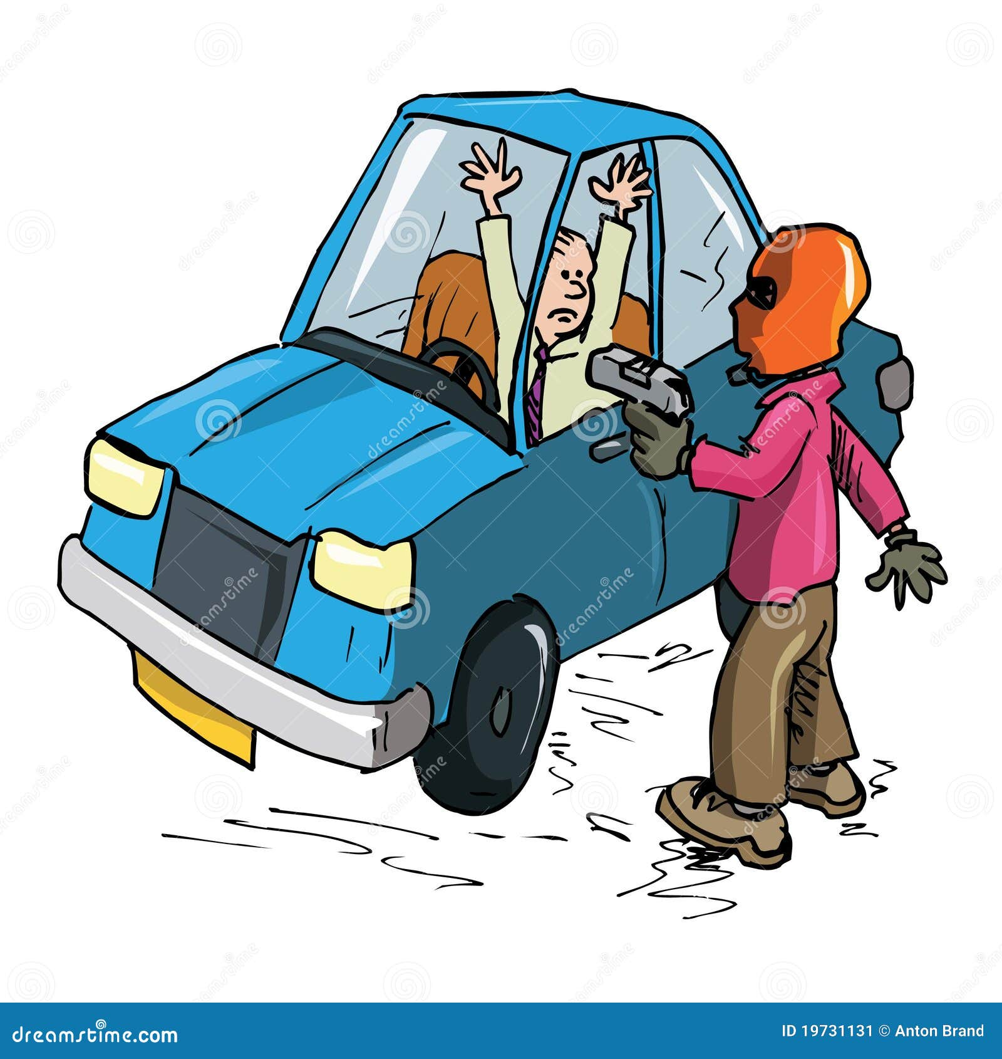





High Level Architecture of JARVIS – 0.001
SVM
Prediction Model
VOSK
model
Violent
Threatening
Text Output
Emergency Call
Audio Input
Normal
No Action

Slide 8


Slide 9
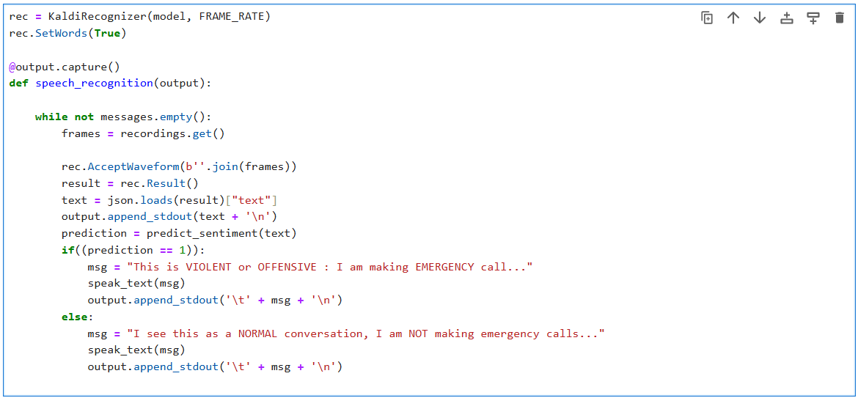

Slide 10
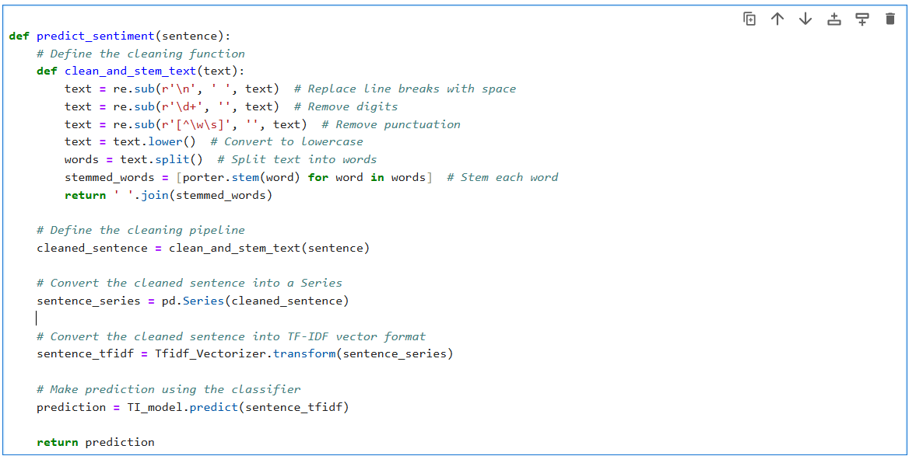

Slide 11
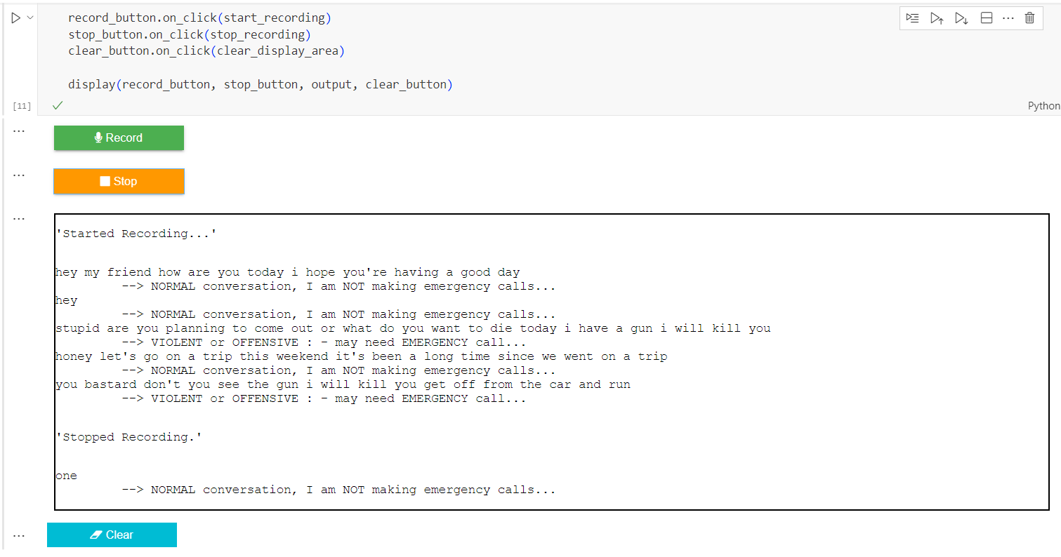

Slide 12

Questions welcome…

Slide 13

Thank You
From…
Sakthiraj Kandasamy
Sundaram Duraisamy
Praveen Suresh

